Slide 1
Lecture 16

Slide 5
Question 223.26.4.6
Suppose I have a spherical mirror and I tell you that s is positive and s’ is negative. What type of mirror might I have
Concave
Convex
Can’t tell

Slide 6
Question 223.16.11
I have a concave mirror. If I place an object closer than the focal distance, the image is
Inverted and has a magnification greater than 1
Not inverted and has a magnification greater than 1
Inverted and has a magnification smaller than 1
Not inverted and has a magnification smaller than 1

Slide 7
Question 223.16.12
Will a refractive spherical optic display spherical aberration?
Yes
No
Sometimes yes, sometimes no

Slide 8
Question 223.15.8
A
C
f
C
f
B
C
f
A ray enters a mirror as shown above. Which of the choices to the right shows how the ray will exit the mirror?
C
C
f

Slide 9
Question 223.15.8
A
C
f
C
f
B
C
f
A ray enters a mirror as shown above. Which of the choices to the right shows how the ray will exit the mirror?
C
C
f

Slide 10
Question 223.15.8
A
C
f
C
f
B
C
f
A ray enters a mirror as shown above. Which of the choices to the right shows how the ray will exit the mirror?
C
C
f

Slide 11
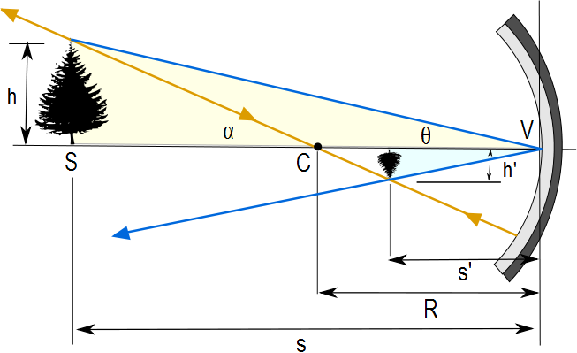
Image Formed by a Concave Mirror
Geometry can be used to determine the magnification of the image
h_{i} is negative when the image is inverted with respect to the object

Slide 12
Concave Mirror, Notation
The mirror has a radius of curvature of R
Its center of curvature is the point C
Point V is the center of the spherical segment
A line drawn from C to V is called the principal axis of the mirror

Slide 14
Paraxial Rays
We use only rays that diverge from the object and make a small angle with the principal axis
Such rays are called paraxial rays
All paraxial rays reflect through the image point

Slide 15
Image Formed by a Concave Mirror
Geometry also shows the relationship between the image and object distances
This is called the mirror equation
If p is much greater than R, then the image point is half-way between the center of curvature and the center point of the mirror
s → ∞ , then 1/ s ≈ 0 and s’ ≈ R/2

Slide 16
Focal Length
When the object is very far away, then s→ ∞ and the incoming rays are essentially parallel
In this special case, the image point is called the focal point
The distance from the mirror to the focal point is called the focal length
The focal length is ½ the radius of curvature

Slide 17
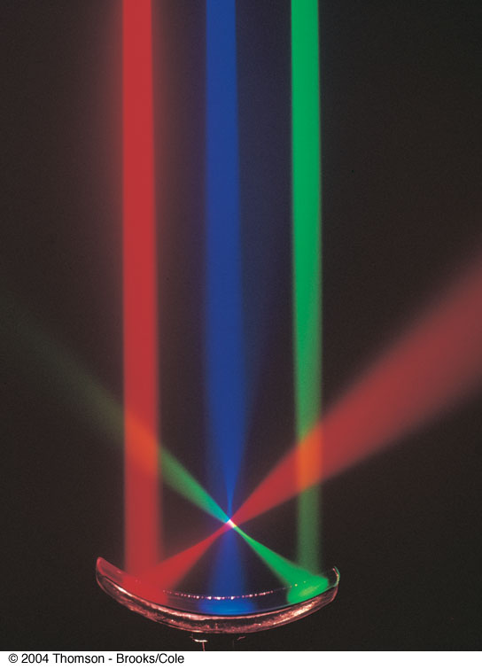
Focal Point, cont.
The colored beams are traveling parallel to the principal axis
The mirror reflects all three beams to the focal point
The focal point is where all the beams intersect
It is the white point

Slide 18
Focal Point and Focal Length, cont.
The focal point is dependent solely on the curvature of the mirror, not on the location of the object
It also does not depend on the material from which the mirror is made
ƒ = R / 2
The mirror equation can be expressed as

Slide 19
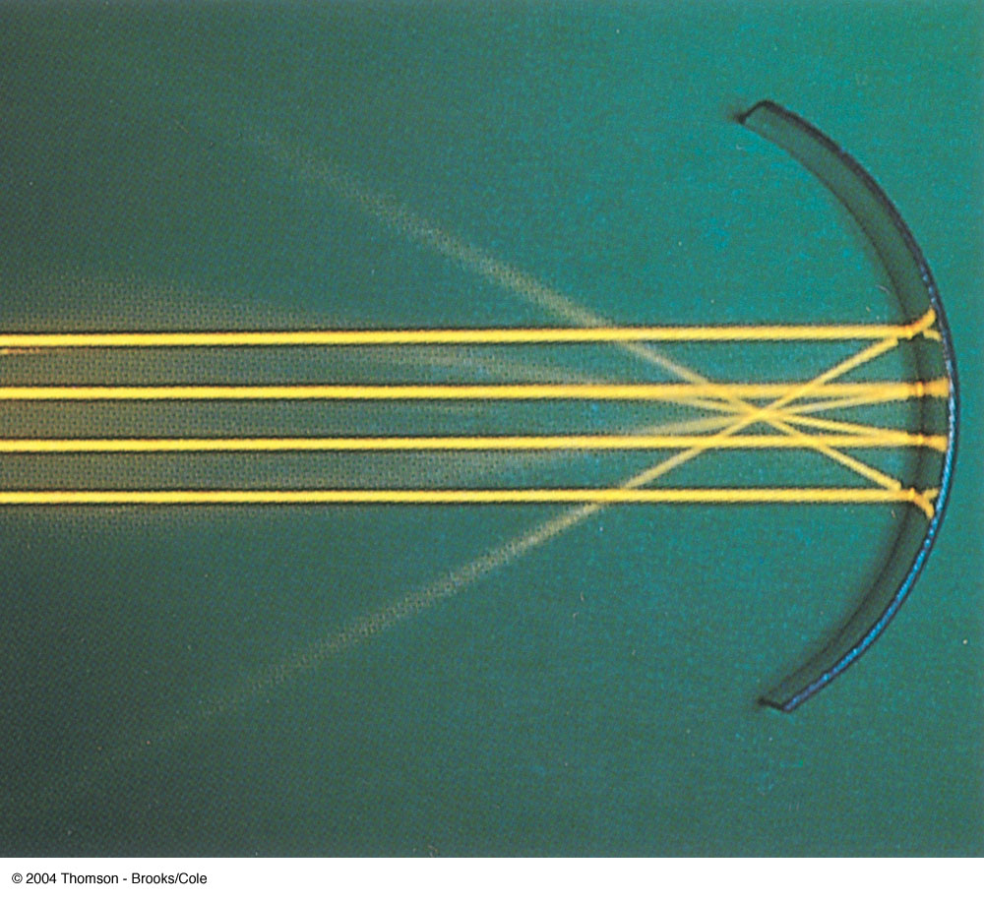
Focal Length Shown by Parallel Rays

Slide 20
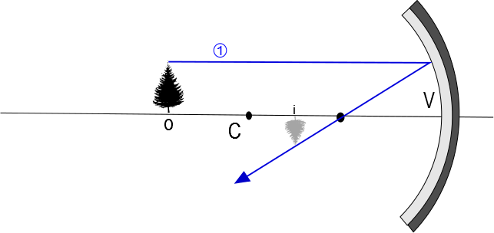

Slide 21
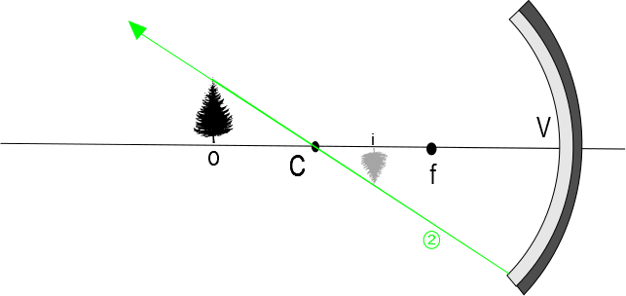

Slide 22
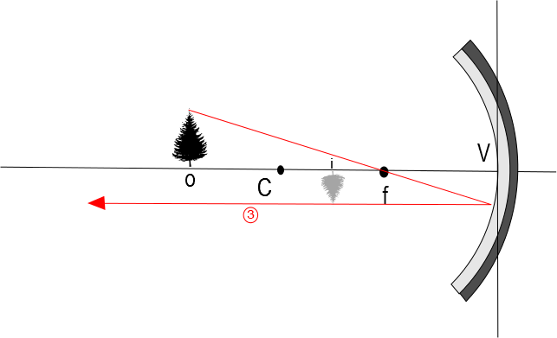

Slide 23
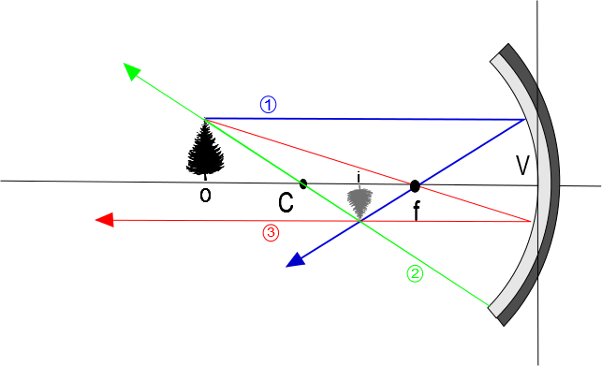

Slide 24
Convex Mirrors
A convex mirror is sometimes called a diverging mirror
The light reflects from the outer, convex side
The rays from any point on the object diverge after reflection as though they were coming from some point behind the mirror
The image is virtual because the reflected rays only appear to originate at the image point

Slide 25
Image Formed by a Convex Mirror
In general, the image formed by a convex mirror is upright, virtual, and smaller than the object

Slide 27
Front
Back

Slide 28
Ray Diagrams
A ray diagram can be used to determine the position and size of an image
They are graphical constructions which reveal the nature of the image
They can also be used to check the parameters calculated from the mirror and magnification equations

Slide 29
Drawing a Ray Diagram
To draw a ray diagram, you need to know:
The position of the object
The locations of the focal point and the center of curvature
Three rays are drawn
They all start from the same position on the object
The intersection of any two of the rays at a point locates the image
The third ray serves as a check of the construction

Slide 30
Ray Diagram – Concave Mirrors
Ray 1 is drawn from the top of the object parallel to the principal axis and is reflected through the focal point, F
Ray 2 is drawn from the top of the object through the focal point and is reflected parallel to the principal axis
Ray 3 is drawn through the center of curvature, C, and is reflected back on itself

Slide 31
Notes About the Rays
The rays actually go in all directions from the object
The three rays were chosen for their ease of construction
The image point obtained by the ray diagram must agree with the value of q calculated from the mirror equation

Slide 32
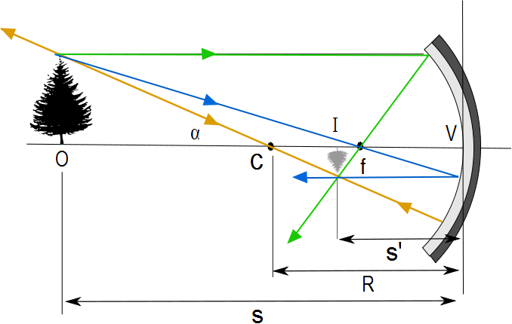
Ray Diagram for a Concave Mirror, s > R
The center of curvature is between the object and the concave mirror surface
The image is real
The image is inverted
The image is smaller than the object (reduced)

Slide 33
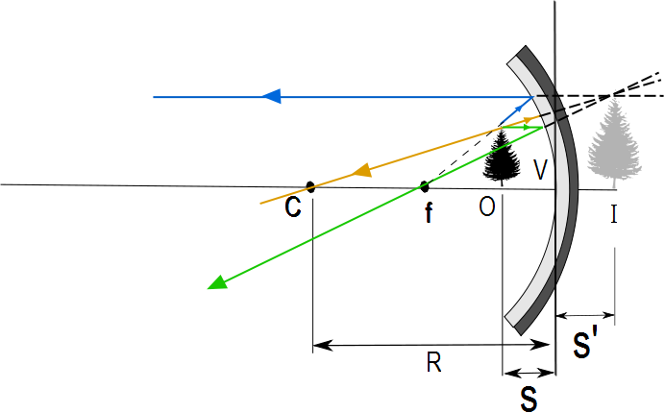
Ray Diagram for a Concave Mirror, s < f
The object is between the mirror surface and the focal point
The image is virtual
The image is upright
The image is larger than the object (enlarged)

Slide 34
The Rays in a Ray Diagram – Convex Mirrors
Ray 1 is drawn from the top of the object parallel to the principal axis and is reflected away from the focal point, F
Ray 2 is drawn from the top of the object toward the focal point and is reflected parallel to the principal axis
Ray 3 is drawn through the center of curvature, C, on the back side of the mirror and is reflected back on itself

Slide 35
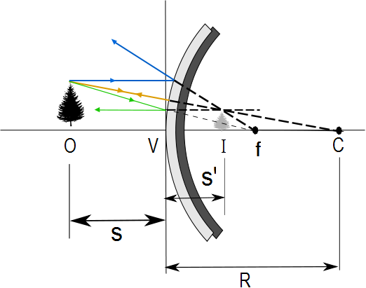
Ray Diagram for a Convex Mirror
The object is in front of a convex mirror
The image is virtual
The image is upright
The image is smaller than the object (reduced)

Slide 36
Notes on Images
With a concave mirror, the image may be either real or virtual
When the object is outside the focal point, the image is real
When the object is at the focal point, the image is infinitely far away
When the object is between the mirror and the focal point, the image is virtual
With a convex mirror, the image is always virtual and upright
As the object distance decreases, the virtual image increases in size

Slide 37
Spherical Aberration
Rays that are far from the principal axis converge to other points on the principal axis
This produces a blurred image
The effect is called spherical aberration

Slide 38
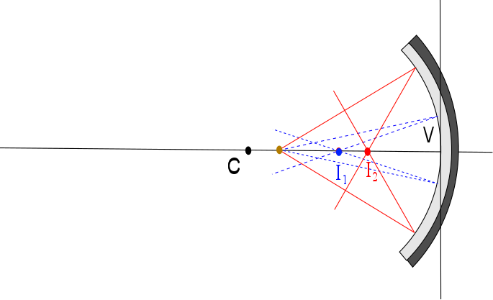

Slide 39
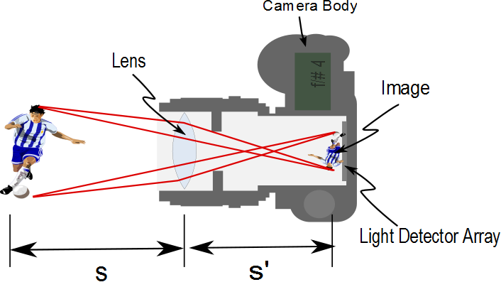

Slide 40
Object
[Figure]
Convergence Point

Slide 41
A
θ₁
θ₂
η
S
d
ψ
α
β
γ
P
V
C
R
s
s’

Slide 42
Sign Convention

Slide 43
Front
Back
Object
[Figure]
Convergence Point

Slide 44
s
s’
Rays from fish
Fish in water
ℓ
Image of Fish
θ₂
θ₁
ℓ
θ₁
θ₂
Rays appear to come from here
n₁ (Large)
n₂ (Small)

Slide 45
END

Slide 46
Question 223.15.3
You are building a camera with refractive lenses. Would you expect all colors of light to focus at the same point?
Yes
No
Can’t tell

Slide 47
Question 223.15.4
What type of lens is a simple magnifier?
Convex
Concave
Diverging
Converging
More than one of the above

Slide 48
Question 223.15.6
A
f
f
f
f
B
f
f
A ray enters a lens as shown above. Which of the choices to the right shows how the ray will exit the lens?
C
f
f

Slide 49
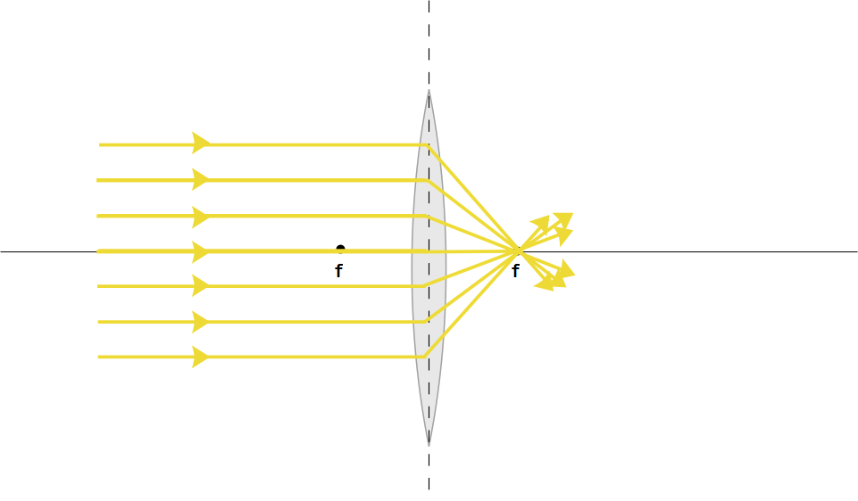

Slide 50
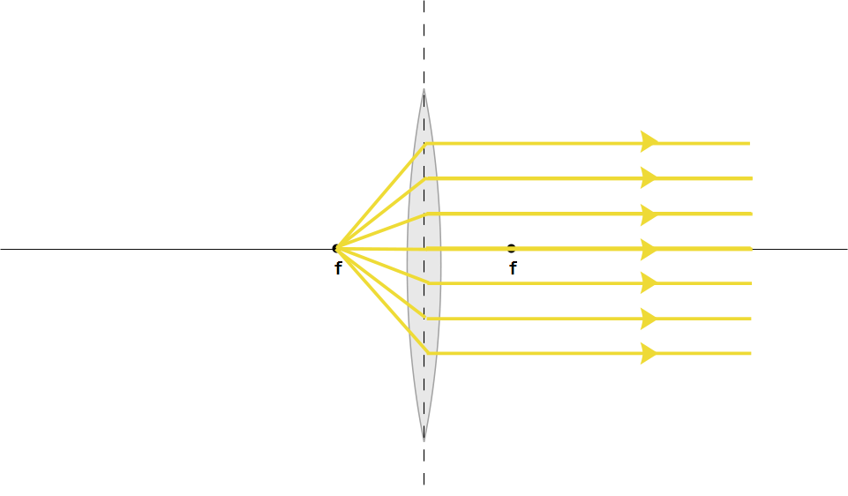

Slide 52
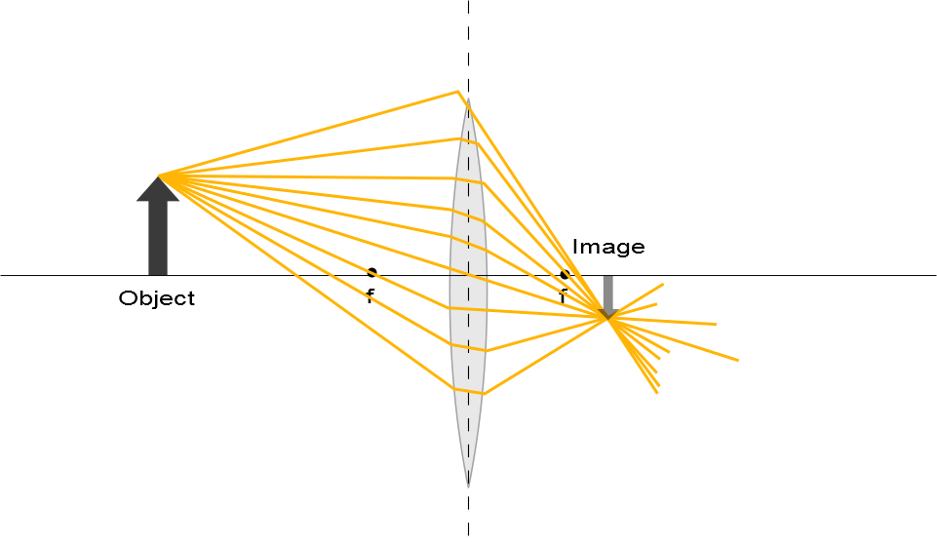

Slide 53
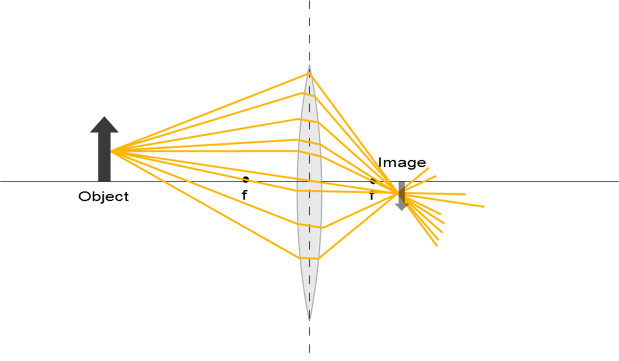

Slide 55
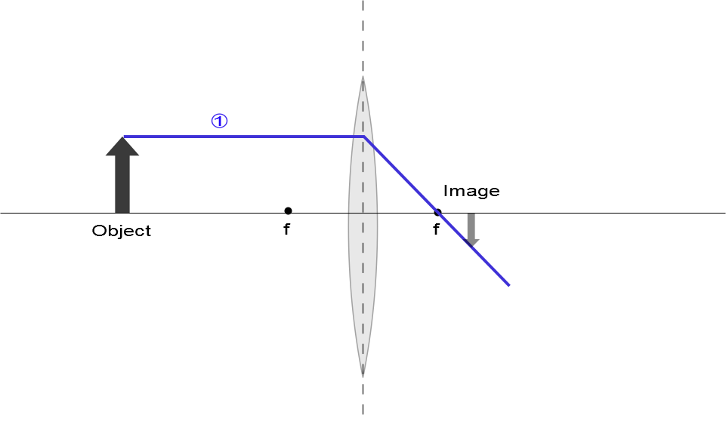

Slide 56
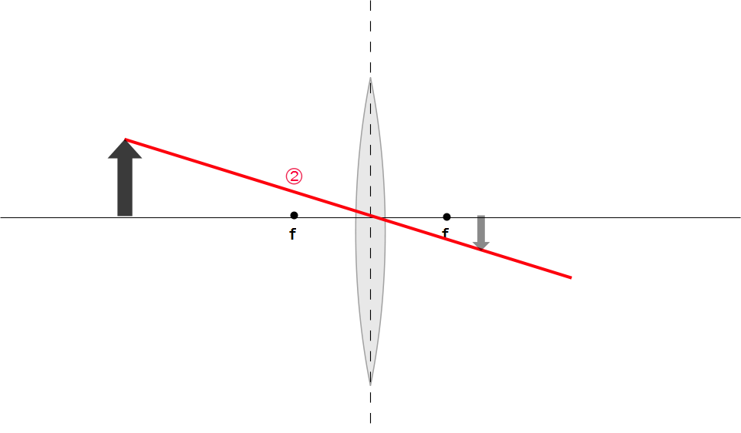
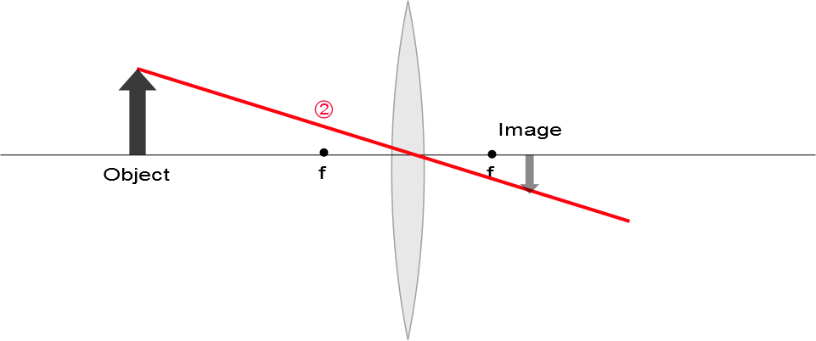

Slide 57
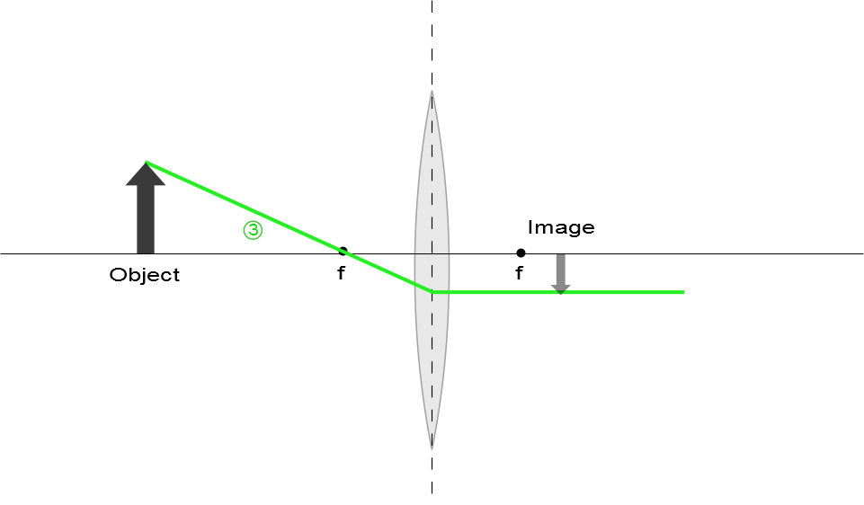

Slide 58
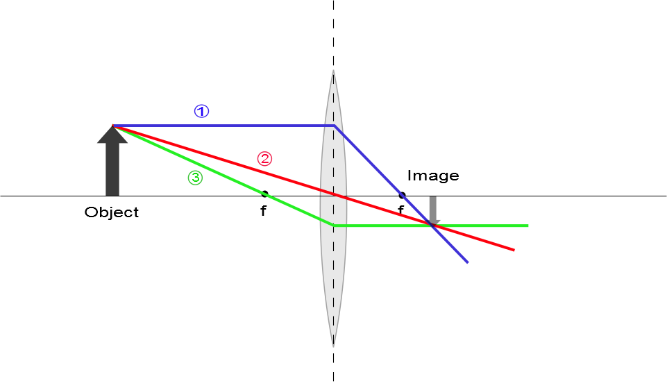
Ray Diagram for Converging Lens, s > f
The image is real
The image is inverted
The image is on the back side of the lens

Slide 59
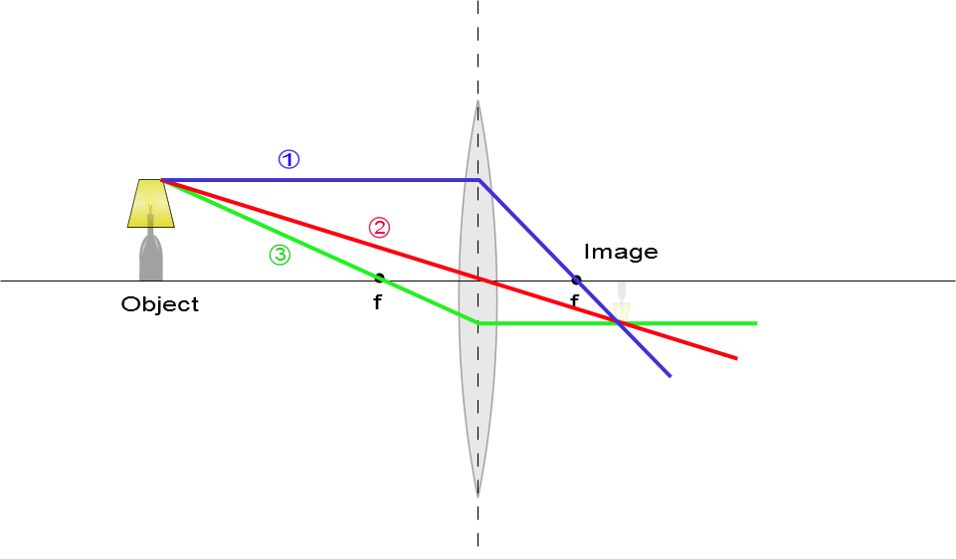
Ray Diagram for Converging Lens, s > f
The image is real
The image is inverted
The image is on the back side of the lens

Slide 60
Question 223.15.7
A
f
f
f
f
B
f
f
A ray enters a lens as shown above. Which of the choices to the right shows how the ray will exit the lens?
C
f
f

Slide 61
Question 223.15.8
A
f
f
f
f
B
f
f
A ray enters a lens as shown above. Which of the choices to the right shows how the ray will exit the lens?
C
f
f

Slide 62
Question 223.15.9
A
f
f
f
f
B
f
f
A ray enters a lens as shown above. Which of the choices to the right shows how the ray will exit the lens?
C
f
f

Slide 63
Question 223.15.10
A
f
f
f
f
B
f
f
A ray enters a lens as shown above. Which of the choices to the right shows how the ray will exit the lens?
C
f
f

Slide 64
Question 223.15.11
A
f
f
f
f
B
f
f
A ray enters a lens as shown above. Which of the choices to the right shows how the ray will exit the lens?
C
f
f

Slide 65
Question 223.15.12
A
f
f
f
f
B
f
f
A ray enters a lens as shown above. Which of the choices to the right shows how the ray will exit the lens?
C
f
f

Slide 66
Question 223.15.13
A
f
f
f
f
B
f
f
A ray enters a lens as shown above. Which of the choices to the right shows how the ray will exit the lens?
C
f
f

Slide 67
Question 223.15.13
A
f
f
f
f
B
f
f
A ray enters a lens as shown above. Which of the choices to the right shows how the ray will exit the lens?
C
f
f

Slide 68
Question 223.15.14
Three rays leave a glowing object and pass through a lens as shown. After passing through the lens, where do they meet?
At f
At the center of the lens
This is silly, they don’t meet anywhere
f
f

Slide 69
Question 223.15.15
Three rays leave a glowing object and pass through a lens as shown. After passing through the lens, where does our brain think they meet?
At f
At the center of the lens
Somewhere behind the lens off to the left
f
f

Slide 70
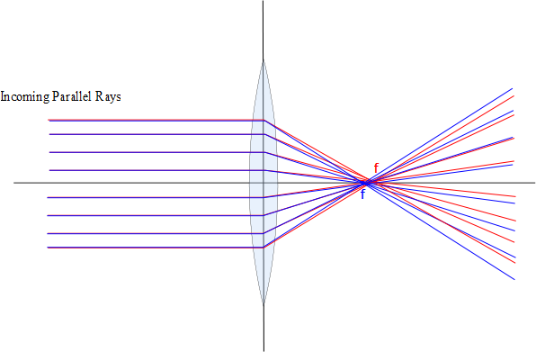

Slide 71
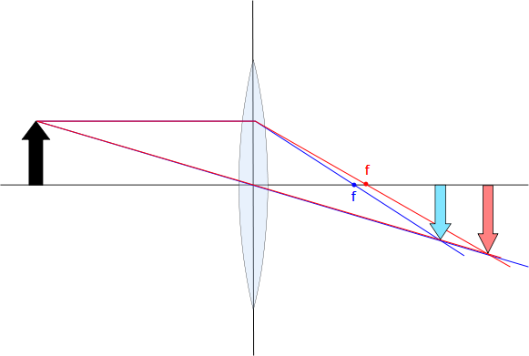

Slide 72
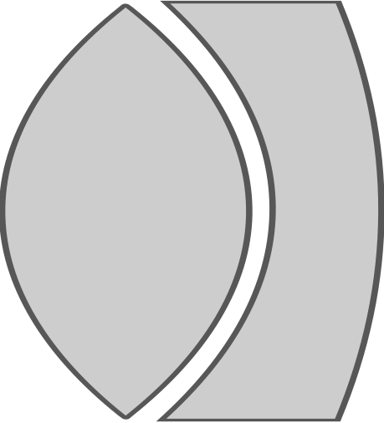


Slide 73
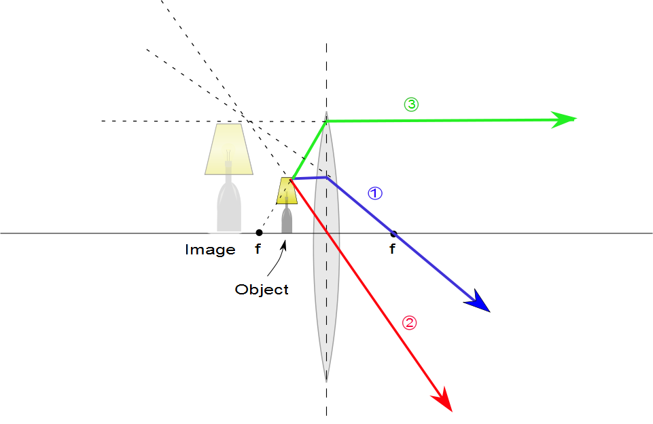
Ray Diagram for Converging Lens, p < f
The image is virtual
The image is upright
The image is larger than the object
The image is on the front side of the lens

Slide 74
Ray Diagrams for Thin Lenses – Diverging
For a diverging lens, the following three rays are drawn:
Ray 1 is drawn parallel to the principal axis and emerges directed away from the focal point on the front side of the lens
Ray 2 is drawn through the center of the lens and continues in a straight line
Ray 3 is drawn in the direction toward the focal point on the back side of the lens and emerges from the lens parallel to the principal axis

Slide 75
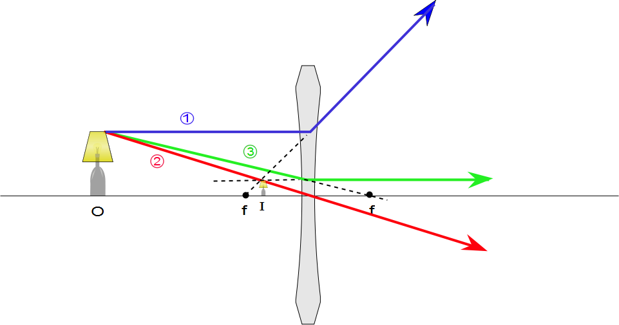
Ray Diagram for Diverging Lens
The image is virtual
The image is upright
The image is smaller
The image is on the front side of the lens

Slide 76
Object
[Figure]
Convergence Point

Slide 77
A
θ₁
θ₂
η
S
d
ψ
α
β
γ
P
V
C
R
s
s’

Slide 78
Sign Convention

Slide 79
Front
Back
Object
[Figure]
Convergence Point

Slide 80
s
s’
Rays from fish
Fish in water
ℓ
Image of Fish
θ₂
θ₁
ℓ
θ₁
θ₂
Rays appear to come from here
n₁ (Large)
n₂ (Small)

Slide 81
Question 223.16.1
What is the focal length of a pane of window glass?
zero
infinity
the thickness of the glass
impossible to determine

Slide 82
Derivation of the Lens Equ.
B
A
C₁
C₂
P
S
n
t
R₂
s₁
s’₂
R₁

Slide 83
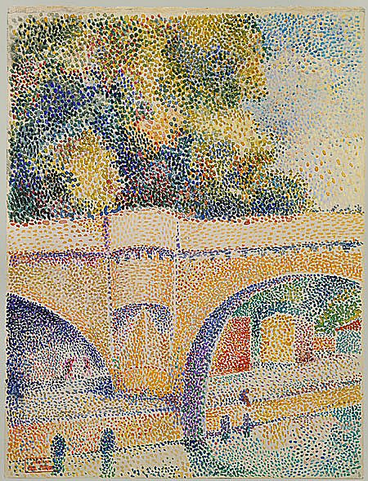

Slide 84
Derivation of the Lens Equ.
B
A
C₁
C₂
P
S
n
t
R₂
s₁
s’₂
R₁

Slide 85
Derivation of the Lens Equ.
A
P₁
C₁
S
n
S’₁
s₁
R₁

Slide 86
Derivation of the Lens Equ.
B
A
A
C₁
P₁
C₁
C₂
P₂
S
n
R₂
S’₁
s’₂
t
s₂

Slide 87
Derivation of the Lens Equ.
B
A
C₁
C₂
P
S
n
t
R₂
s₁
S’₂
R₁

Slide 88
Derivation of the Lens Equ.
R₁
S
C₂
n
C₁
P
R₂
s
s’

Slide 89
P₃
P₂
P₁
S₁
S₂
S₃
S
S’

Slide 91
Question 223.16.2
If the image is on the same side of the air-glass interface as the object, we call this a virtual image. What would be the sign of the image distance, s’?
Positive
Negative
Neutral

Slide 92
Question 223.16.3
If the image inverted, what is the sign of the image height?
Positive
Negative
Neutral

Slide 93
Question 223.16.4
If the image is inverted, what is the sign of the magnification?
Positive
Negative
Neutral

Slide 94
Question 223.16.5
What would
Be for a thin lens?
The radius ratio
The lens thickness
The lens width
The focal length

Slide 95
Question 223.16.6
The professor tells us that we will find the thin lens formula by making the image of a dot of light. This is OK because…
No one takes pictures of anything but dot’s of light
He is lazy and does not want to do anything bigger than a dot
A dot of light images into a complete picture, like the Mona Lisa
We can think about any extended body as consisting of emitting or reflecting dots.

Slide 96
Derivation of the Lens Equ.
Front
Back
R₁
S
C₂
n
C₁
P
R₂
s
s’

Slide 97
h
θ
I
O
n
θ
h’
s
s’

